Slide 1
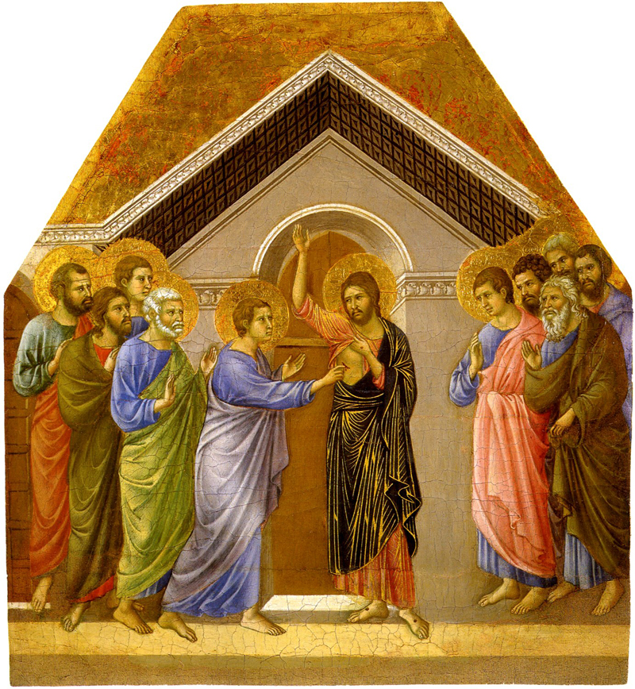
John 20.19-31
image by Duccio
Museo dell’Opera del Duomo; Sienna, Italy
taken from Vanderbilt.edu

Slide 2
John 20.19-20 NASB: So when it was evening on that day, the first day of the week, and when the doors were shut where the disciples were, for fear of the Jews, Jesus came and stood in their midst and said to them, “Peace be with you.” And when He had said this, He showed them both His hands and His side. The disciples then rejoiced when they saw the Lord.
Jesus probably spoke in Hebrew, שָׁלוֹם [shah-LOME]

Slide 3
John 20.21-23:
So Jesus said to them again, “Peace be with you; as the Father has sent Me, I also send you.”
And when He had said this, He breathed on them and said to them, “Receive the Holy Spirit.”
“If you forgive the sins of any, their sins have been forgiven them; if you retain the sins of any, they have been retained.”

Slide 4
John 20.21-23: So Jesus said to them again, “Peace be with you; as the Father has sent Me, I also send you.”
God
why did the Father send the Son?
how did the Son pursue his mission?
what does that tell us about the mission of the Son’s disciples?
Church
Jesus
People

Slide 5
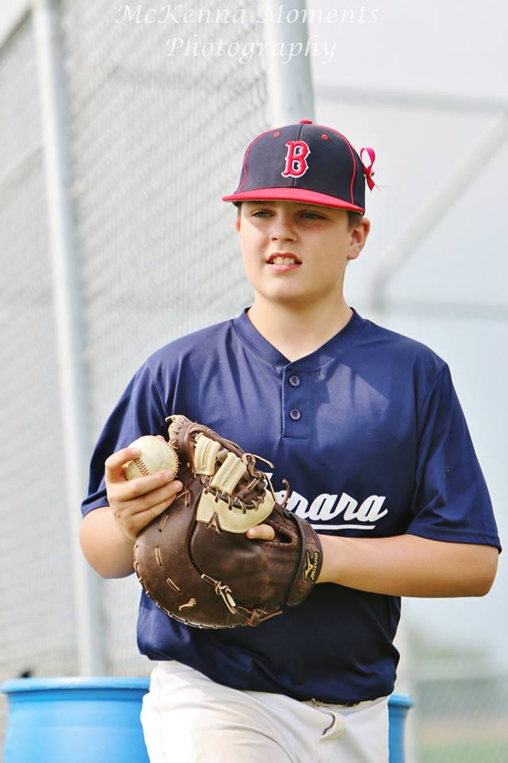
John 20.22: And when He had said this, He breathed on them and said to them, “Receive the Holy Spirit.”
why did the Son give the Spirit?
what is the symbolism of breathing?
how does this relate to Acts 2 events?

Slide 6
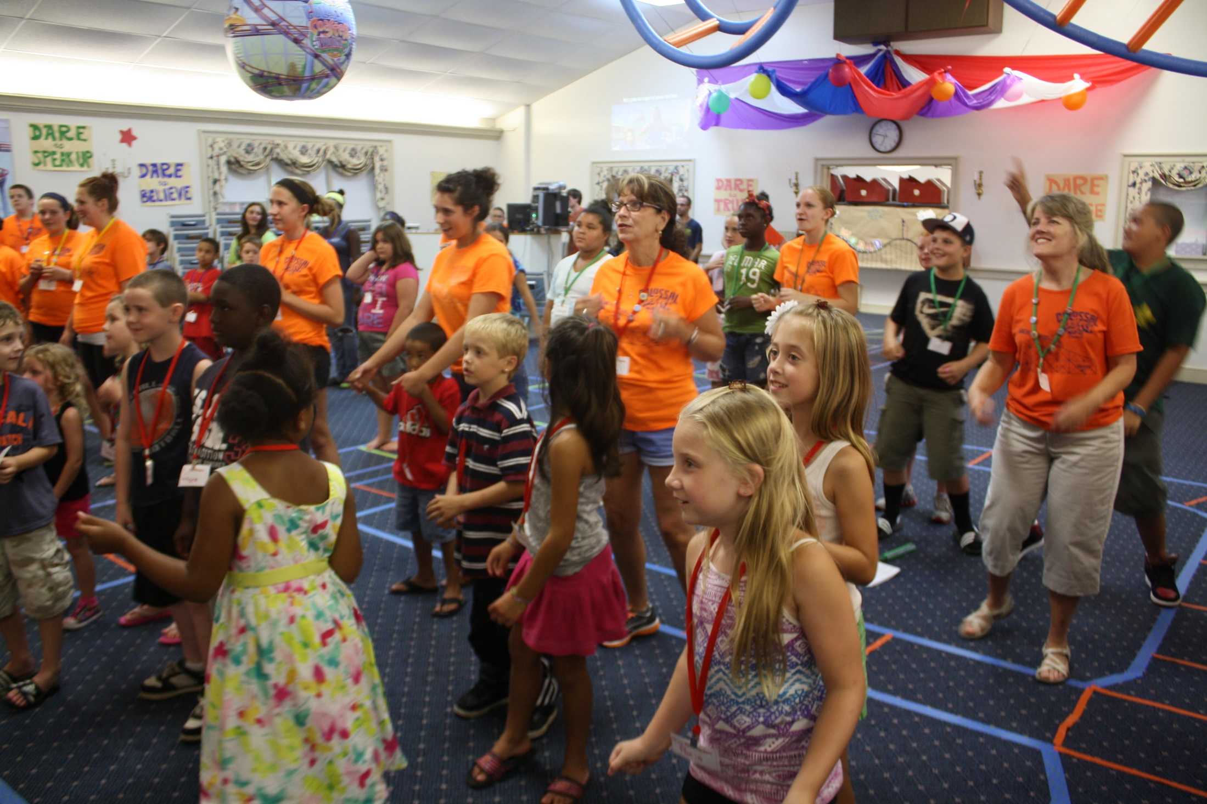
John 20.23: “If you forgive the sins of any, their sins have been forgiven them; if you retain the sins of any, they have been retained.”
how does this derive from 20.21-22?
what does this mean?

Slide 7
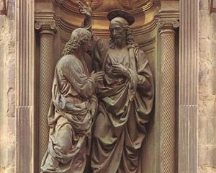
John 20.24-25: But Thomas, one of the twelve, called Didymus, was not with them when Jesus came. So the other disciples were saying to him, “We have seen the Lord!” But he said to them, “Unless I see in His hands the imprint
of the nails, and
put my finger into
the place of the
nails, and put my
hand into His side,
I will not believe.”
by Andrea del Verrocchio
Orsanmichele Florence, Italy
taken from wikiart.org

Slide 8
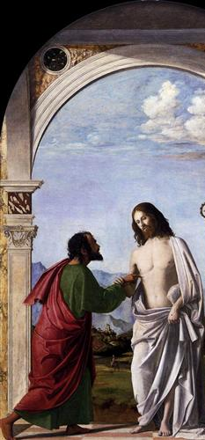
John 20.26-28: After eight days His disciples were again inside, and Thomas with them. Jesus came, the doors having been shut, and stood in their midst and said, “Peace be with you.” Then He said to Thomas, “Reach here with your finger, and see My hands; and reach here your hand and put it into My side; and do not be unbelieving, but believing.” Thomas answered and said to Him, “My Lord and my God!”
by Cima da Conegliano
Gallerie dell’ Accademia / Venice, Italy / wikiart.org

Slide 9
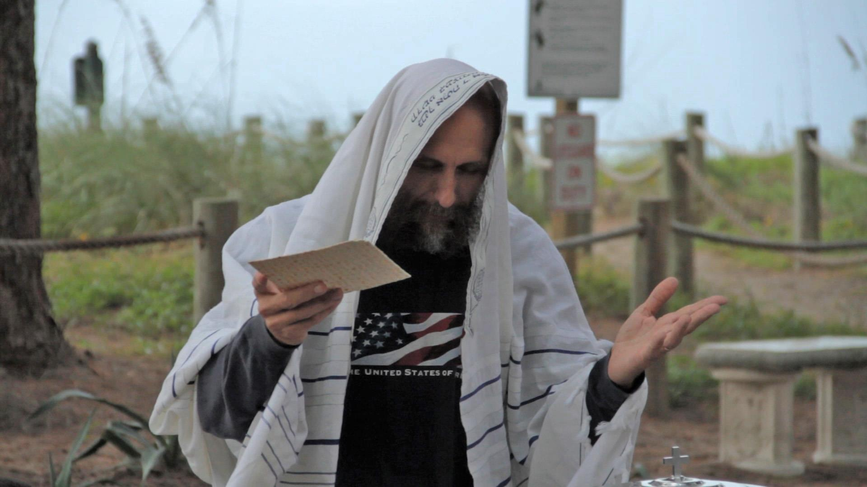
John 20.29: Jesus said to him, “Because you have seen Me, have you believed? Blessed are they who did not see, and yet believed.”
captured from live footage of Pastor Charlie Garrett preaching at Turtle Beach

Slide 10
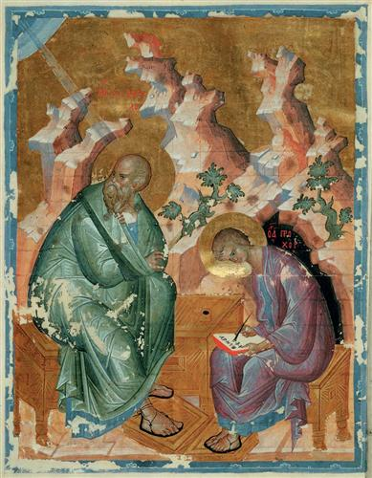
John 20.30-31: Therefore many other signs Jesus also performed in the presence of the disciples, which are not written in this book; but these have been written so that you may believe that Jesus is the Christ, the Son of God; and that believing you may have life in His name.
John the Evangelist by Andrei Rublev / Russian State Library, Moscow / wikiart.org

Slide 11
John 20.19-31
image by Duccio
Museo dell’Opera del Duomo; Sienna, Italy
taken from Vanderbilt.edu

